Slide 1
Computer Network (CS3002)
Spring Semester (2021-2022)
Dr. Judhistir Mahapatro
Department of Computer Science and Engineering
National Institute of Technology Rourkela

Slide 2
Introduction to Computer Networks (Lecture-3)

Slide 3
The TCP/IP Reference Model Layers
Reference model used in ARPANET, and its successor, the worldwide Internet.
ARPANET was a research network sponsored by the DoD, US.
  Eventually connected hundreds of universities and government installations, using leased telephone lines.
  When satellite and radio networks were added, existing protocols had trouble internetworking with them.
  The architecture later become known as the TCP/IP reference model

Slide 4
The TCP/IP Reference Model Layers
DoD wants the network be able to survive loss of subnet hardware, without existing conversations being broken off after at a notice by a attack from the Soviet Union.

Slide 5
The TCP/IP Reference Model Layers
Link layer
Internet layer
Transport layer
Application layer

Slide 6
Link layer
Describes what links such as serial lines and classical Ethernet must do to meet the needs of this connectionless internet layer.
An interface between hosts and transmission links.

Slide 7
Internet layer
The requirements that led to the choice of a packet-switching network based on a connectionless layer that runs across different networks.
Its job is to permit hosts to inject packets into any network and have them travel independently to the destination.
Reordering of packets will be done by the higher layers.

Slide 8
Internet layer
Internet layer defines
  an official packet format and protocol called IP (Internet Protocol),
  plus a companion protocol called ICMP (Internet Control Message Protocol) that helps it function.
Packet routing is a major issue.
IP has not proven effective at avoiding congestion.

Slide 9
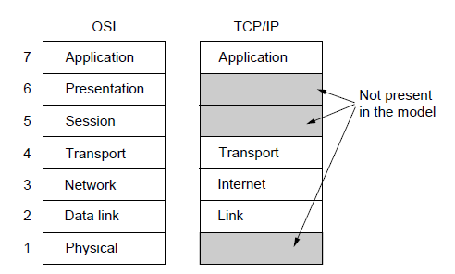
The TCP/IP Reference Model
The TCP/IP reference model

Slide 10
Transport layer
It provides two end-to-end transport protocols
TCP (Transmission Control Protocol): reliable connection-oriented protocol that allows a byte stream originating on one machine to be delivered without error on any other machine.
  Converts incoming byte stream into discrete messages and passes to the Internet layer.
  At receiving end, it reassembles the received messages into the output stream.
  Handles flow control

Slide 11
Transport layer
UDP (User datagram Protocol): unreliable connectionless protocol for applications that do not want TCP’s sequencing or flow control
  Prompt delivery is important than accurate delivery
  Example, Speech or video transmission.

Slide 12
Application layer
Applications simply include any session or presentation functions that they require.
It contains all the higher-level protocols such as Telnet, FTP, and SMTP.
DNS (Domain Name System), for mapping host names onto their network addresses.
HTTP for delivering the web page contents.
RTP for delivering real-time media such as voice or movie.

Slide 13
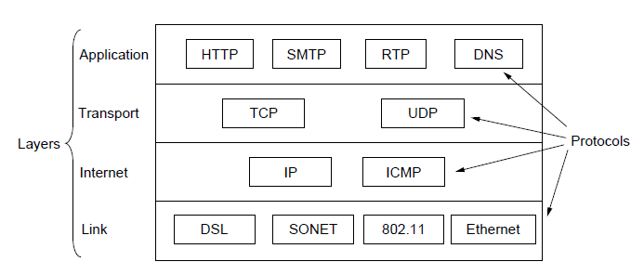
The TCP/IP Reference Model
The TCP/IP reference model with some protocols

Slide 14
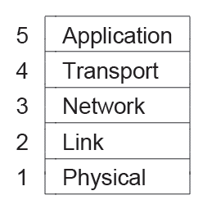
The Model Used
The reference model used

Slide 15
OSI versus TCP/IP Reference Models
Concepts central to OSI model
Services:
  each layer performs some services for the layer above it.
  Service definition tells what the layer does, not how entities above it access it or how the layer works.
Interfaces
  Layer’s interface tells the processes above it how to access it.
  Specifies what the parameters are and what results to expect.
  Says nothing about how the layer works inside too.

Slide 16
OSI versus TCP/IP Reference Models
Protocols
  Protocols used in a layer are the layer’s own business.
  It can use any protocol it wants to
  It can change them at will without affecting the software in higher layers.
These ideas fit very nicely with modern ideas about object-oriented programming.

Slide 17
OSI versus TCP/IP Reference Models
TCP/IP model did not distinguish between services, interfaces and protocols, retrofit it after the fact to make it more like OSI-like.
  Only service provided by internet layer are SEND IP PACKET and RECEIVE IP PACKET.
  Protocols in the OSI model are better hidden than in the TCP/IP model.
  Protocols can be replaced very easily due to technology change.
  The main purpose of layering is that being able to make changes transparently.

Slide 18
OSI versus TCP/IP Reference Models
OSI Model was devised before the protocols were invented.
  Not biased towards any set of protocols
  Downside is that designers did not have much experience with the subject and did not have good idea of which functionality to put in which layer.
  For example, data link layer originally dealt with point-to-point networks. When broadcast network came around, a new sub-layer had to be hacked into the model.

Slide 19
OSI versus TCP/IP Reference Models
With TCP/IP, the protocols came first
  the model was really just a description of the existing protocols.
  Only trouble is that the model did not fit any other protocol stacks.
  Useful for TCP/IP networks.

Slide 20
OSI versus TCP/IP Reference Models
OSI model has seven layers and TCP/IP model has four.
OSI supports both connectionless and connection-oriented communication in the network layer,
  but only connection-oriented communication in the transport layer.
TCP/IP supports only one mode in the network layer (connectionless) but both in the transport layer.

Slide 21
Critique of the OSI Model and Protocols
Bad timing.
  Standards came too early
  TCP/IP protocols were already in widespread, used by many research universities
Bad technology.
  Choice of layers is political than technical
  Session and Presentation are nearly empty
Bad implementations.
  Initial implementations were huge, unwieldy and slow
Bad politics.

Slide 22
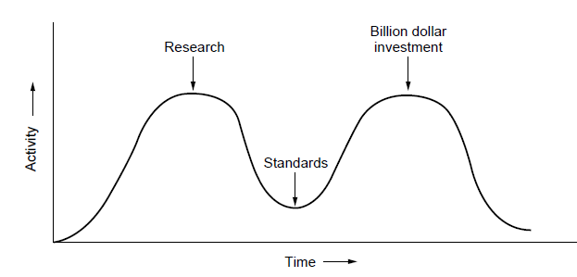
OSI Model Bad Timing
The apocalypse of the two elephants.

Slide 23
Example Networks
Internet
ARPANET
NSFNET
Third-generation mobile phone networks
Wireless LANs: 802.11
RFID and sensor networks

Slide 24
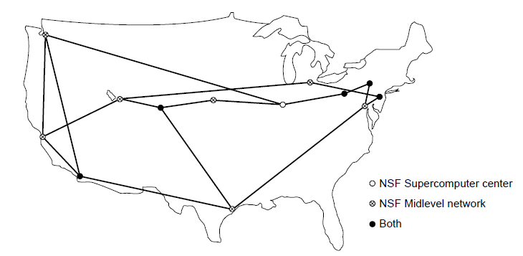
NSFNET
The NSFNET backbone in 1988.

Slide 25
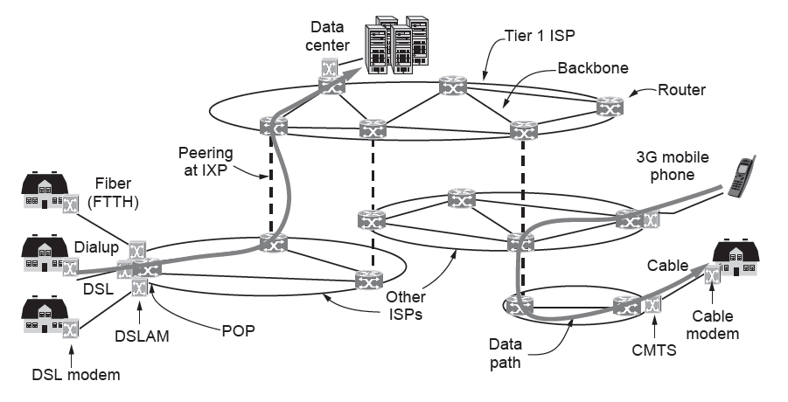
Architecture of the Internet
Overview of the Internet architecture

Slide 26
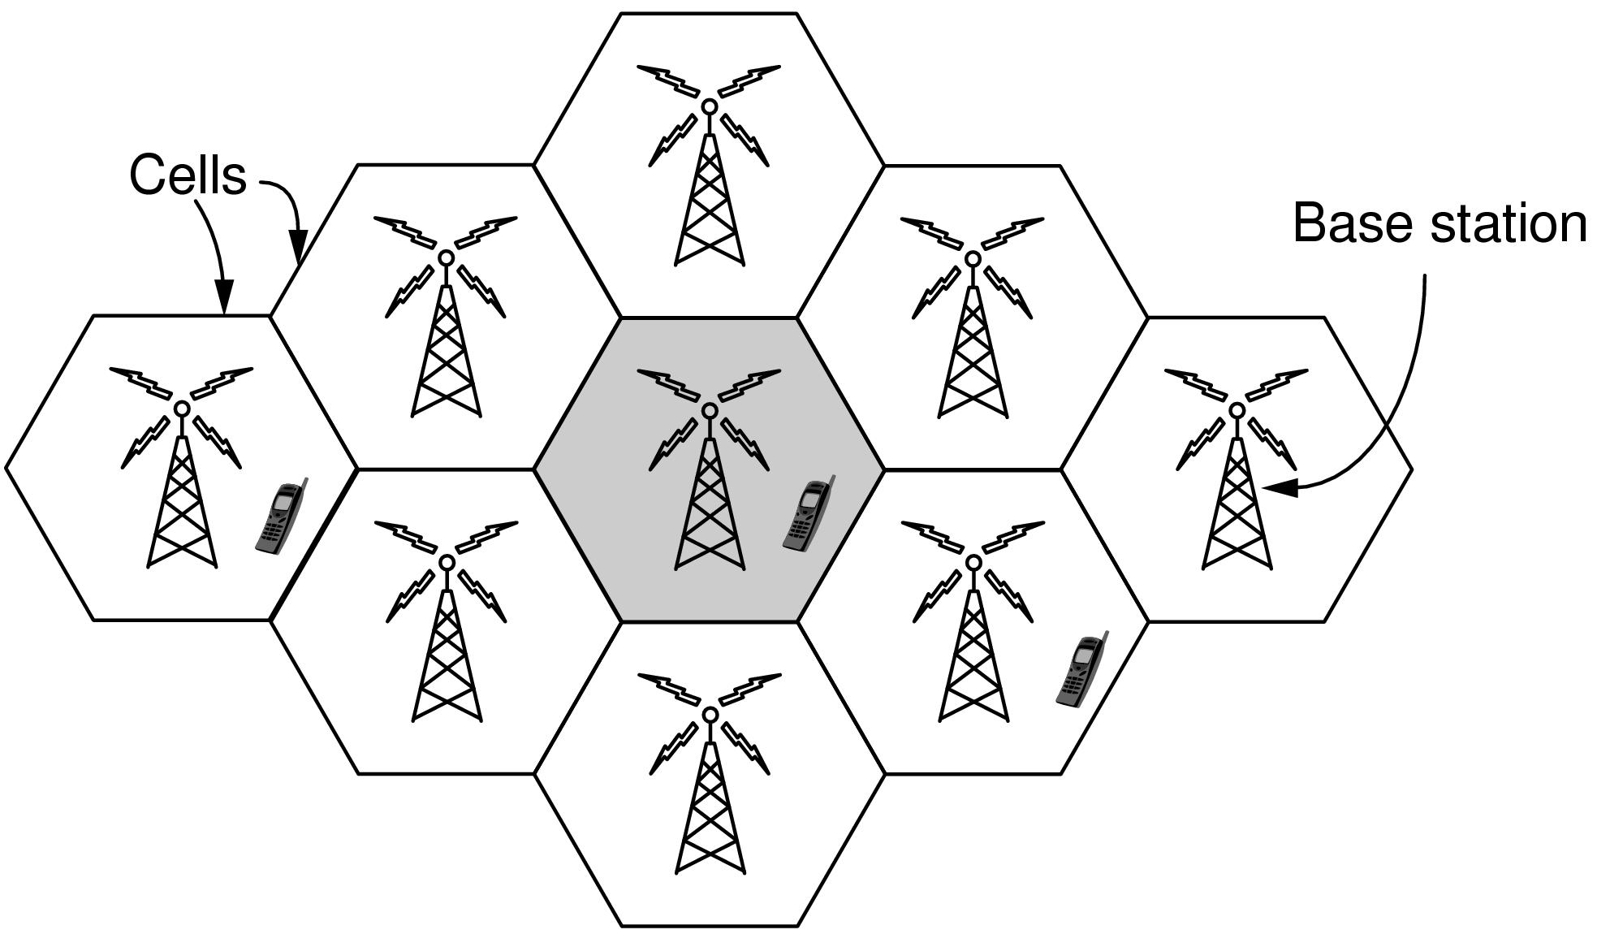
Third-Generation Mobile Phone Networks
Cellular design of mobile phone networks

Slide 27
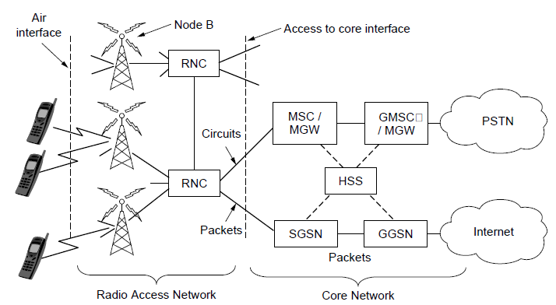
Third-Generation Mobile Phone Networks
Architecture of the UMTS 3G mobile phone network.

Slide 28
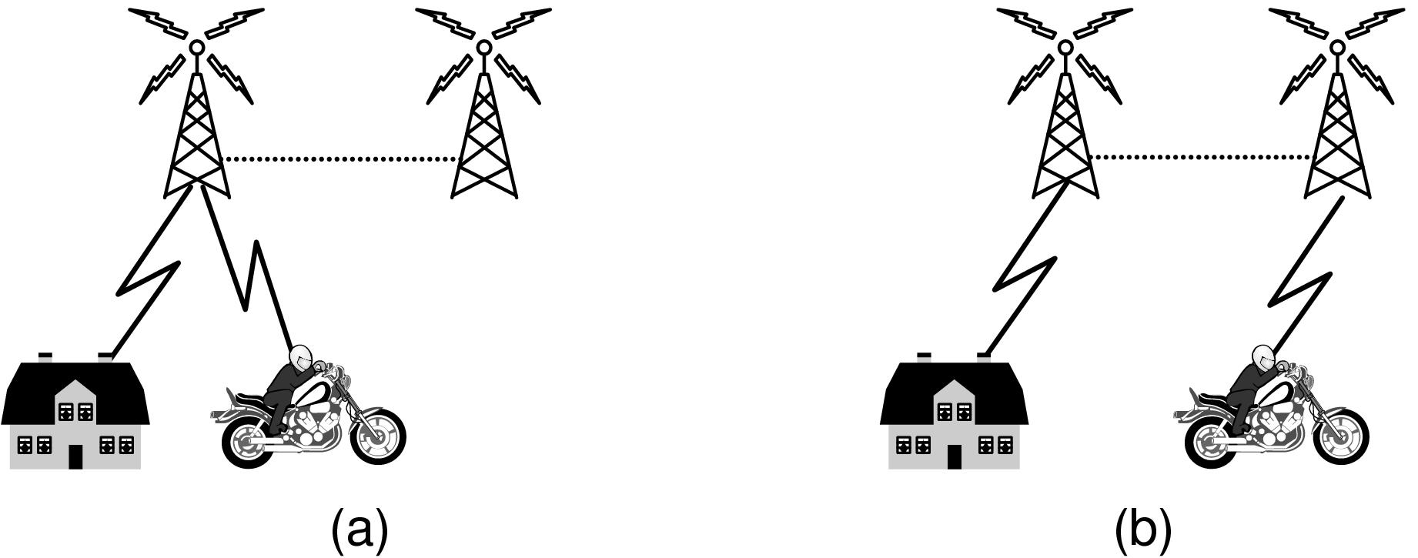
Third-Generation Mobile Phone Networks
Mobile phone handover (a) before, (b) after.

Slide 29
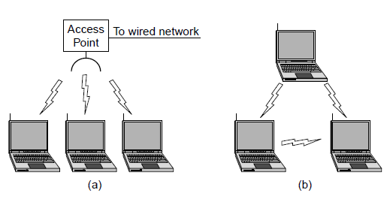
Wireless LANs: 802.11
Wireless network with an access point.
Ad hoc network.

Slide 30
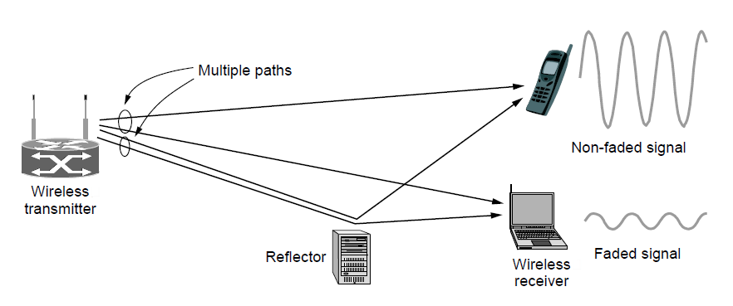
Wireless LANs: 802.11 (2)
Multipath fading

Slide 31
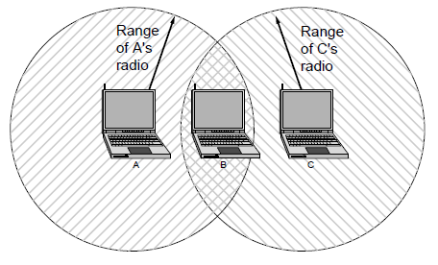
Wireless LANs: 802.11 (3)
The range of a single radio may not cover the entire system.

Slide 32
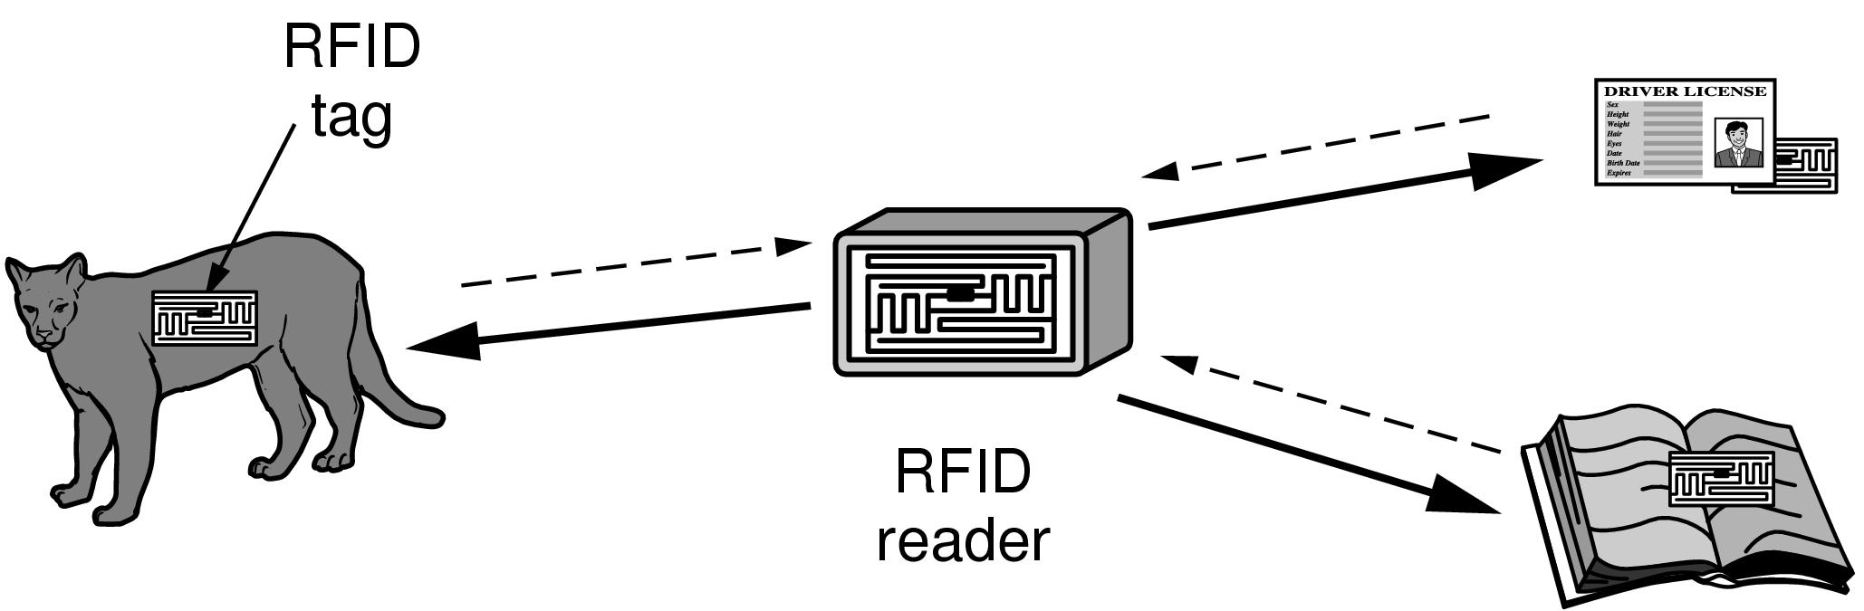
RFID and Sensor Networks (1)
RFID used to network everyday objects.

Slide 33
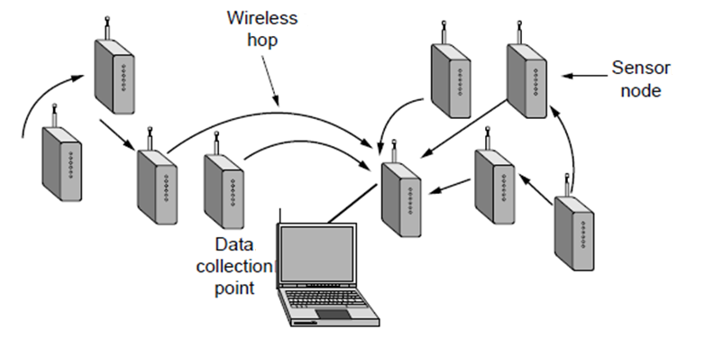
RFID and Sensor Networks
Multihop topology of a sensor network

Slide 34
Network Standardization
Who’s Who in telecommunications
Who’s Who in international standards
Who’s Who in internet standards

Slide 35
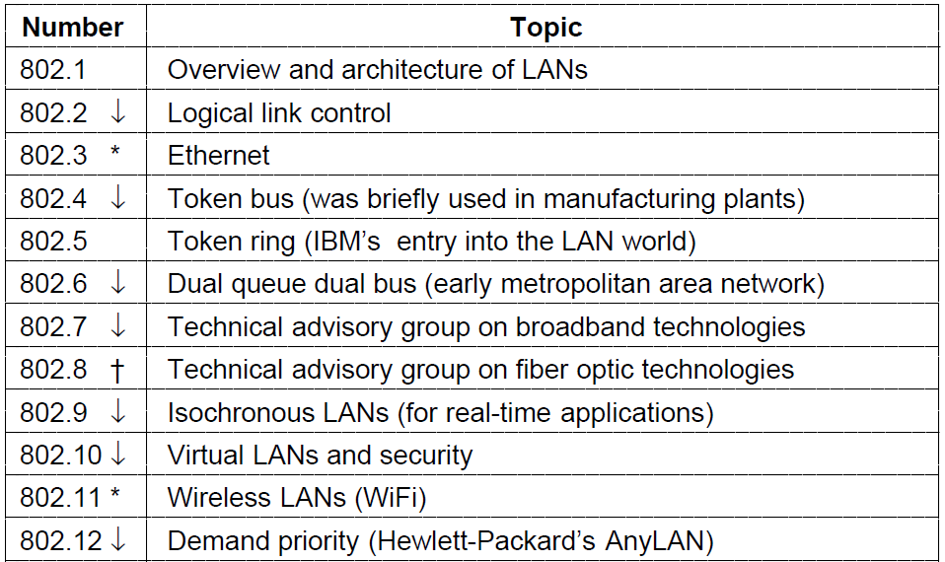
Who’s Who in International Standards
The 802 working groups. The important ones are marked with *.
The ones marked with ↓ are hibernating. The one marked with † gave up and disbanded itself.

Slide 36
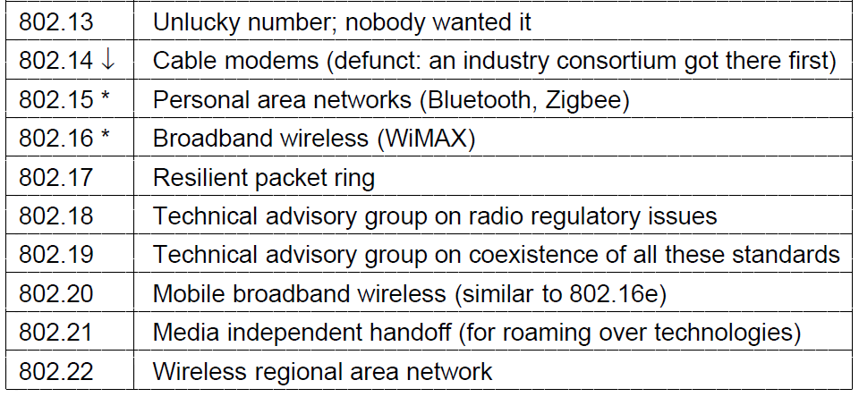
Who’s Who in International Standards
The 802 working groups. The important ones are marked with *.
The ones marked with ↓ are hibernating. The one marked with † gave up and disbanded itself.

Slide 37
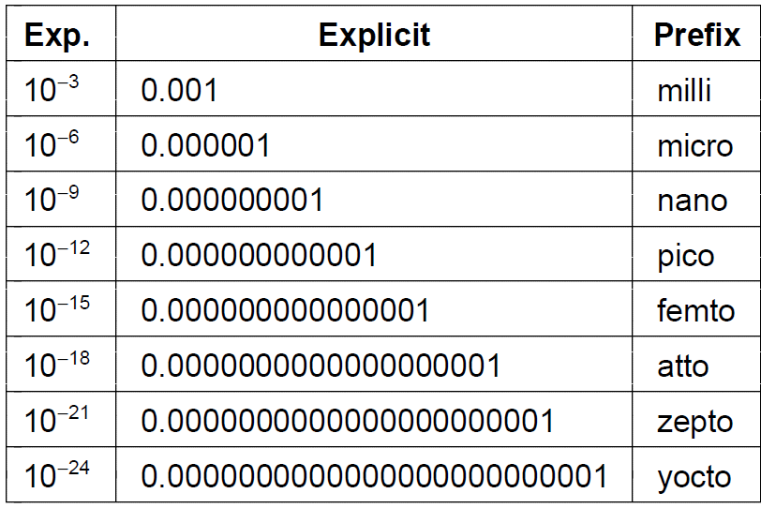
Metric Units
The principal metric prefixes

Slide 38
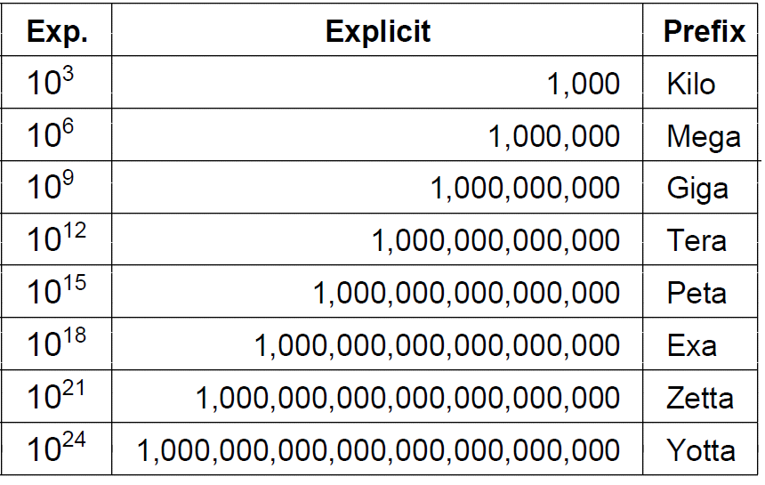
Metric Units (2)
The principal metric prefixes

Slide 39
Reference
Computer Networks, Fifth Edition by Andrew Tanenbaum and David Wetherall, Pearson Education-Prentice Hall, 2011

